Slide 1
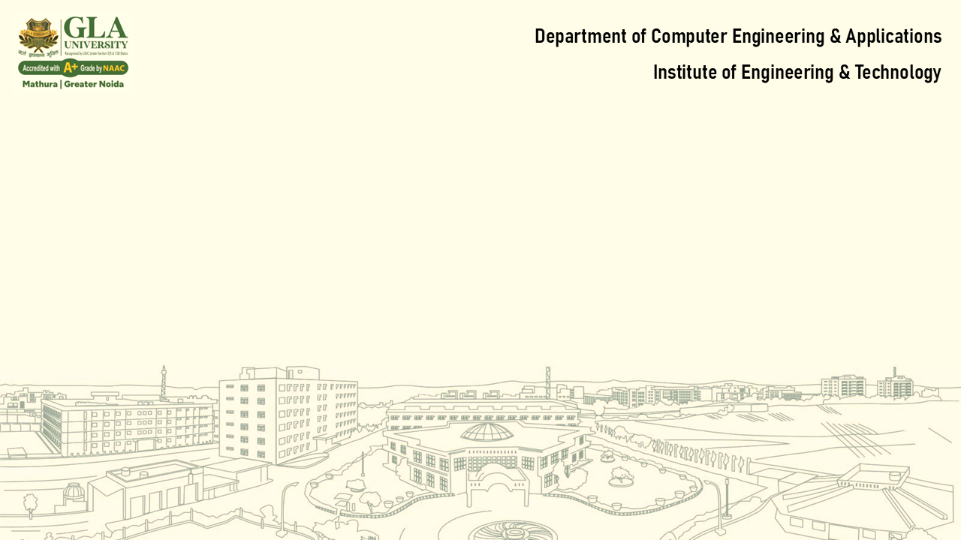
Lecture 1: Introduction to Operating Systems & System Architecture
Core Topics:
Definition and Functions of OS
Types of OS: Batch, Time-sharing, Distributed, Real-time
Kernel, Shell, System Calls
System Architecture: Monolithic, Microkernel, Layered

Slide 2

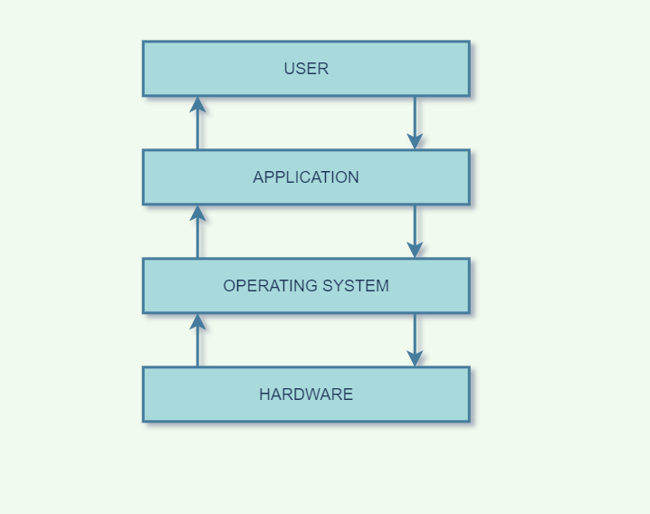
What is an Operating System?
Definition: System software that manages hardware and software resources.
Functions:
- Process Management
- Memory Management
- File System Management
- Device Management
- Security & Access Control
- User Interface

Slide 3
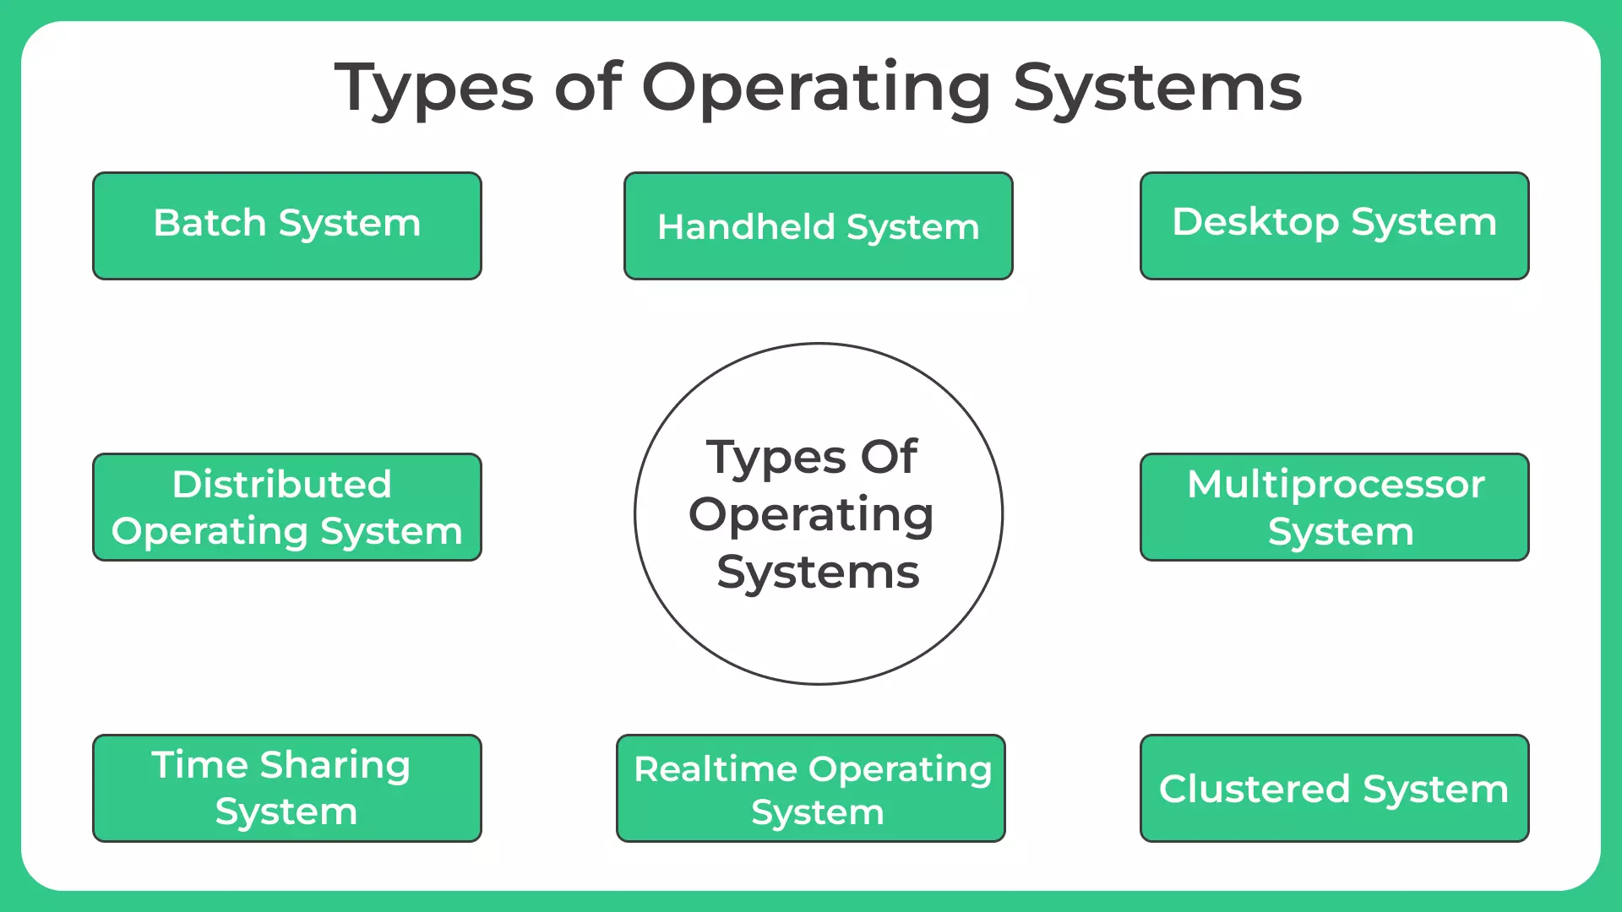
Types of Operating Systems

Slide 4
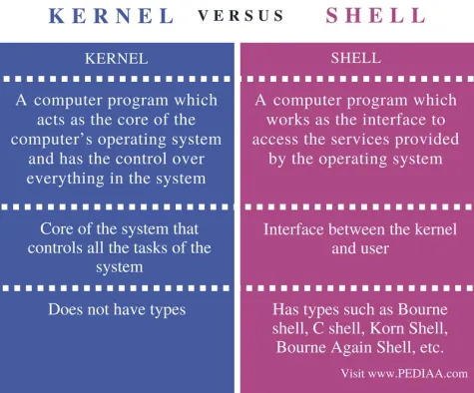
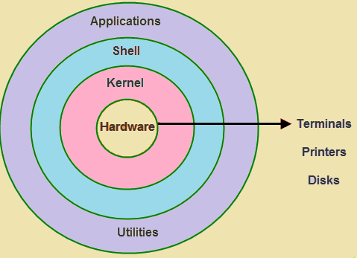
Kernel and Shell

Slide 5
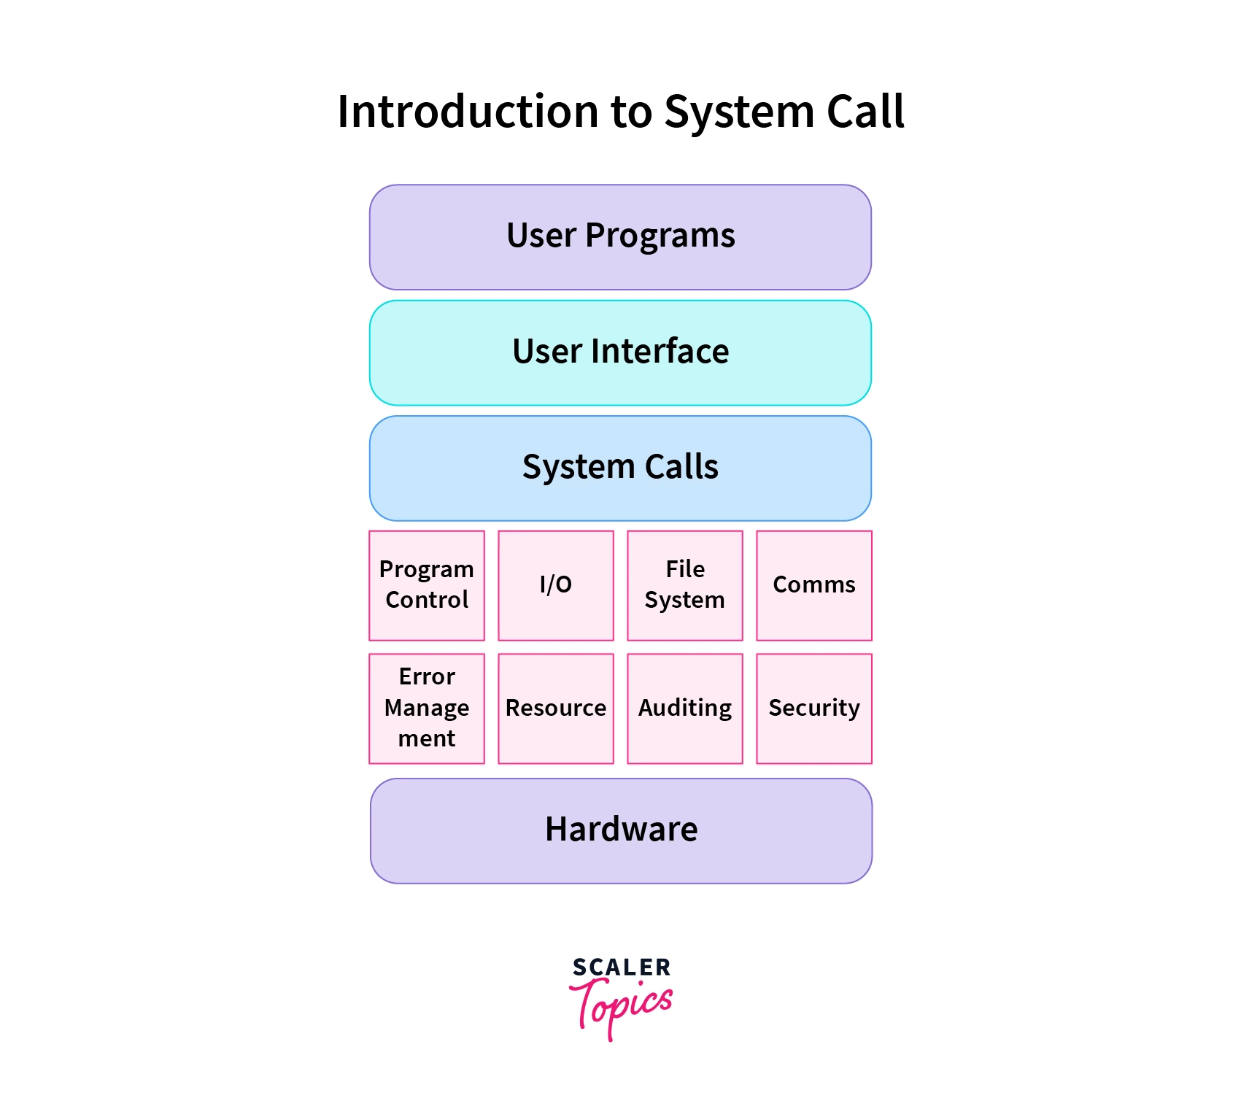
System Calls
Interface between user applications and the OS.
Provides services like:
- Process Control
- File Management
- Device Management
- Information Maintenance
- Communication

Slide 6

System Architecture Overview
Defines how OS components are organized and interact.
Three Common Architectures:
- Monolithic
- Microkernel
- Layered

Slide 7
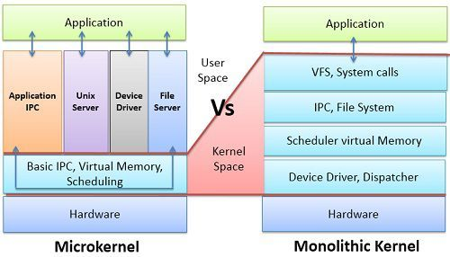
System Architecture Comparison

Slide 8
Slow Learner Activities

Slide 9
Slow Learners Activity 1
Activity 1: Match the OS Types with Their Descriptions
Description Cards:
Used to run jobs in groups with little or no user interaction.
Allows multiple users to use the system at the same time by dividing CPU time.
Coordinates multiple computers to appear as a single system.
Provides quick and predictable response time, used in critical systems.

Slide 10
Slow Learners Activity 2
Activity 2: Role Play Cards – OS Components
Instructions: Assign each student a role and act out how a command flows from user to hardware and back.
Roles and Script:
User: "I want to open a file."
Shell: "I’ll take the user's command and pass it to the system call."
System Call: "I’m the gateway between user and kernel. I’ll pass the request to the kernel."
Kernel: "I’ll manage hardware and send the command to the right device."
Hardware: "I’ll open the file from memory and send it back."
Each student reads their line and passes the command to the next.

Slide 11
Slow Learners Activity 3
Activity 3: Fill-in-the-Blanks Worksheet – OS Vocabulary
Word Bank: Kernel, Shell, User, Hardware, System Call
Worksheet:
The __________ is the person who uses the computer.
The __________ interprets user commands and communicates with the OS.
The __________ is the core of the OS and manages resources.
The __________ helps user programs talk to the OS.
The OS controls the __________ like CPU, memory, and I/O devices.

Slide 12
Slow Learners Activity 4
Activity 4: Color and Label OS Architecture Layers
Blocks to Color:
Application → Blue
Shell → Green
Kernel → Yellow
Hardware → Red
Functions to Write Inside Each Block:
Application: Sends commands to the system
Shell: Converts user commands to system calls
Kernel: Manages memory, CPU, devices
Hardware: Executes operations requested by OS

Slide 13
Moderate Learner Activities

Slide 14
Moderate Learners Activity 1
1. OS Feature Comparison Table
Feature / OS | Windows 10 | Linux Ubuntu | macOS | Android
Open Source?
GUI Available?
Used In
Package Management
Customizable?
Please fill the above table?

Slide 15
Moderate Learners Activity 2
2. Kernel Types Sorting Game
Please place the operating system under the correct kernel architecture.
OS List:
Windows
Linux
macOS
QNX
MINIX
MS-DOS
Categories:
Monolithic Kernel
Microkernel
Hybrid Kernel

Slide 16
Moderate Learners Activity 3
3. System Call Tracing Task
You are given a user-level task : "Open a file in a text editor."
please trace the system call path by writing or drawing: You can use the flowchart

Slide 17
Moderate Learners Activity 4
OS Architecture Diagram Completion
Application Layer
Shell
System Call Interface
Kernel
Hardware
Create the block diagram.

Slide 18
Fast Learner Activities

Slide 19
Fast Learners Activity 1
1. Industry Use-Case Research & Presentation
Task: In pairs or small groups, choose 1 industry from the list and create a short presentation on how RTOS is used.
Example Industries:
Automotive (e.g., Anti-lock Braking System)
Aviation (e.g., Flight Control Systems)
Medical (e.g., Patient Monitoring Devices)
Robotics (e.g., Real-time Sensor Fusion)
Industrial Automation (e.g., Conveyor belt controllers)

Slide 20
Fast Learners Activity 1
1. Industry Use-Case Research & Presentation
Presentation Guidelines:
What is the real-time requirement?
Why is RTOS essential?
Name of the OS used (e.g., VxWorks, FreeRTOS)
Consequences of OS failure

Slide 21
Fast Learners Activity 2
2. Embedded OS Case Study Writing
Task: Individually, choose a device with an embedded OS and write a short case study.
Sample Devices:
Smartwatch (e.g., Apple Watch → watchOS)
Smart TV (e.g., Tizen OS)
Digital Camera
Home Assistant Device (e.g., Alexa → Fire OS)
Fitness Tracker

Slide 22
Fast Learners Activity 2
2. Embedded OS Case Study Writing
Content to Include:
What OS is used?
What are its limitations & benefits?
How is it optimized for hardware?
Why can't a general-purpose OS be used here?
Deliverable: 1-page case study or poster presentation

Slide 23
Fast Learners Activity 3
3. Debate: General-Purpose OS vs Real-Time OS
Task: Divide fast learners into two teams and host a structured debate.
Motion:
“Real-Time Operating Systems should replace General-Purpose OS in all critical systems.”
Team A – Pro RTOS: Emphasize reliability, low latency, deterministic behavior Team B – Pro GPOS: Highlight flexibility, multi-user support, UI capabilities

